Slide 1
HCMUS AI INNOVATION
LingoLoom – advanced LLM application for English Learning
Team HATAL
LLM

Slide 2
Table of contents
01
06
02
07
Team Introduction
Research Methodology
Problem Statement
Research Instrumentation
03
Overview
04
Objectives
05
Desired Outcome

Slide 3
01
INTRODUCTION
Le Trong Duc Anh | – | 21127005
Nguyen Quoc Anh | – | 21127007
Nguyen Tan Loc | – | 21127099
Mac Tuan Trung | – | 21127462
Tran Trung Hieu | – | 21127608

Slide 4
02
PROBLEM STATEMENT

Slide 5


Background
In today's globalized world, learning English is essential for communication, business, travel, and education, benefiting both students and professionals.
Common methods for learning English include traditional, online courses, self-study using books and materials for cost-effectiveness, and mobile apps/websites like Duolingo, Study4 and Babbel.

Slide 6
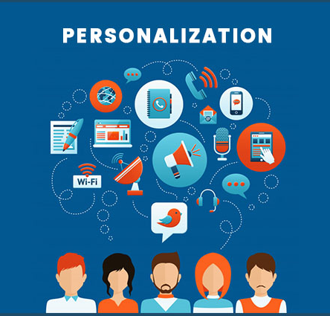


Problem Statement
Current English learning apps face significant limitations, such as
Lack of personalization
Inadequate speaking and pronunciation practice
Superficial grammar and writing feedback
Monotonous and repetitive content
Inconsistent quality in teaching methods and materials, leading to inefficiencies and user frustration.

Slide 7

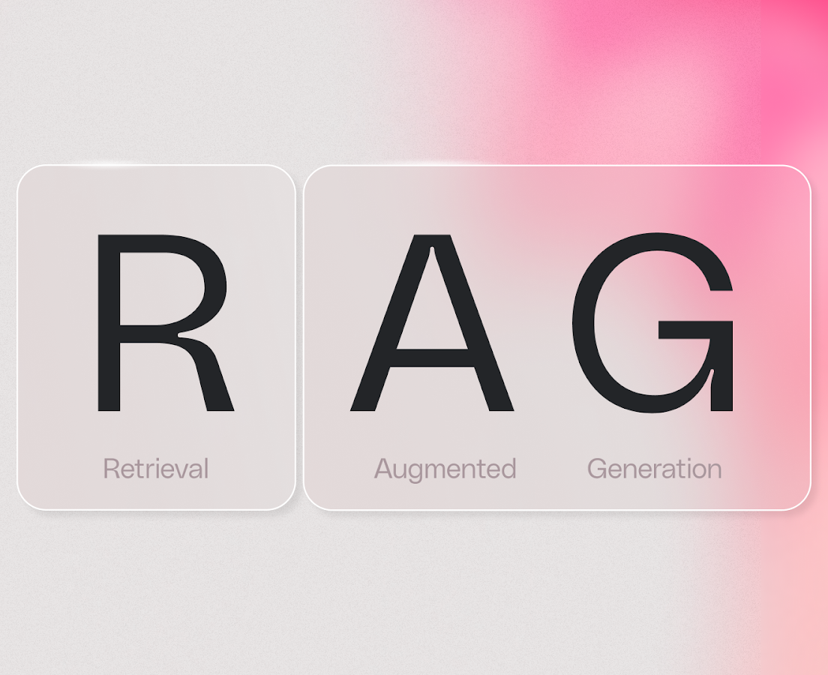
03. Overview
LingoLoom is an advanced English learning platform using LLMs for personalized, engaging, and effective education.

Slide 8


04. Objective
Harness the power of Large Language Models (LLMs)
Integrate RAG & Function Calling to deliver a personalized experience

Slide 9



04. Objective
Effective educational experience
Personalization & adapting to individual learning needs
Real-time feedback and wealthy resources

Slide 10




05. Desired Outcome
English Playground By LLM
Vocabulary Stack By Function Calling
User Tracking And Personalization By RAG
Application

Slide 11








05. Desired Outcome – Core Functions
English Playground By LLM
4 Skills
Content generated by AI + RAG
Free Vocabulary
Available Topics
AI-Generated Topics from User Description
Level Up System

Slide 12
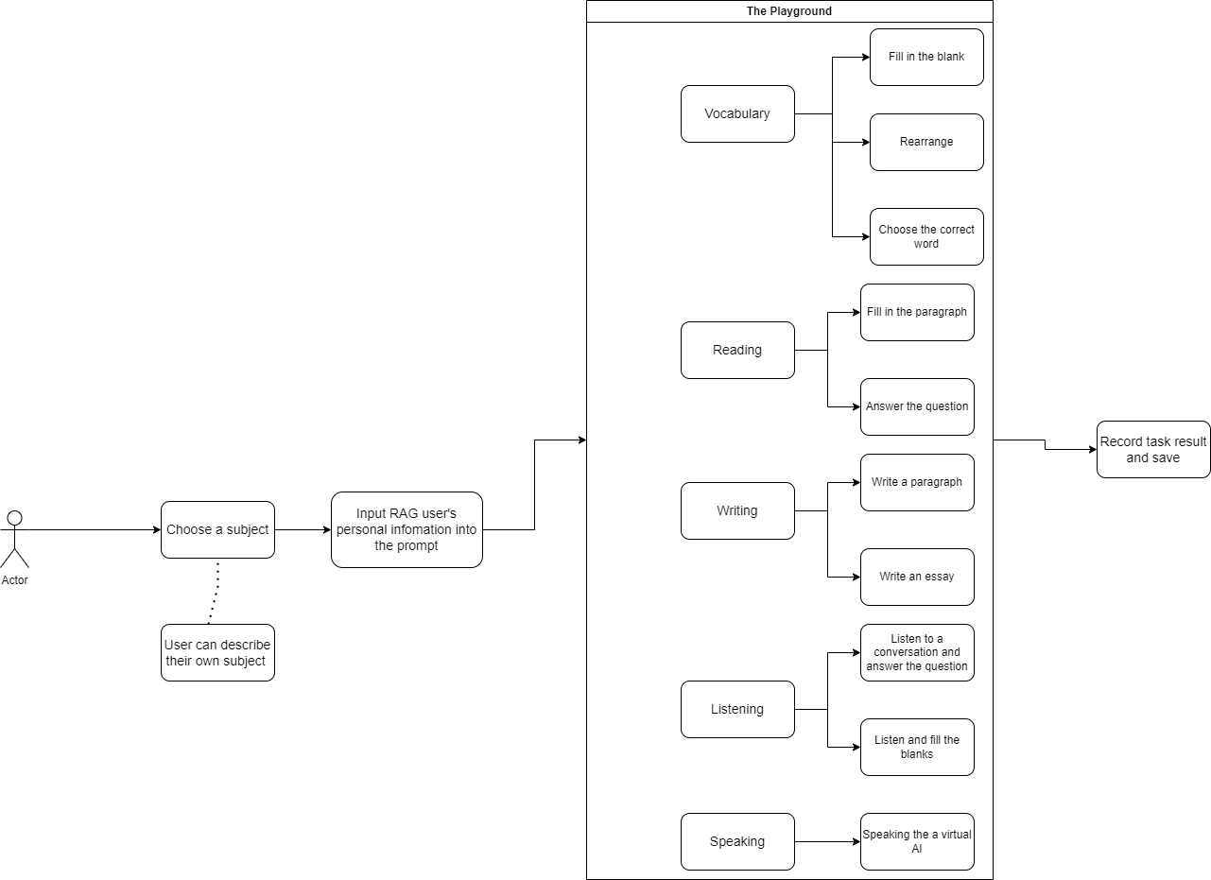
05. Desired Outcome – Core Functions
English Playground By LLM - Simple flowchart

Slide 13
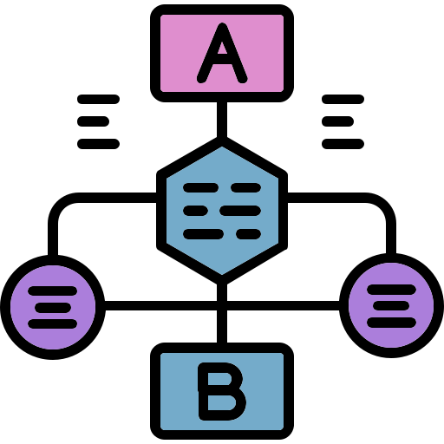


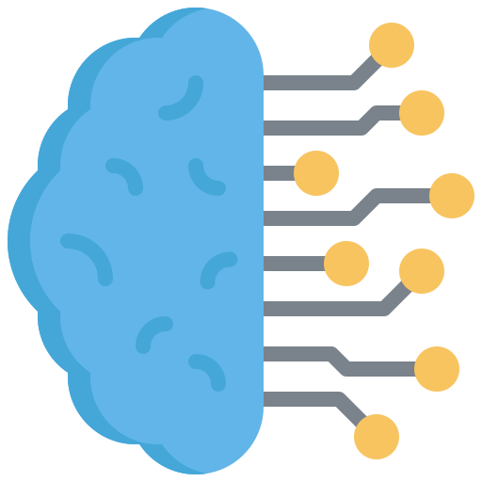
05. Desired Outcome – Core Functions
Vocabulary Stack
3 Word Levels:
New words
Good used words
Common words
Vocabulary By LLM
for more contextual understanding
Dictionary by LLM and Function Calling

Slide 14
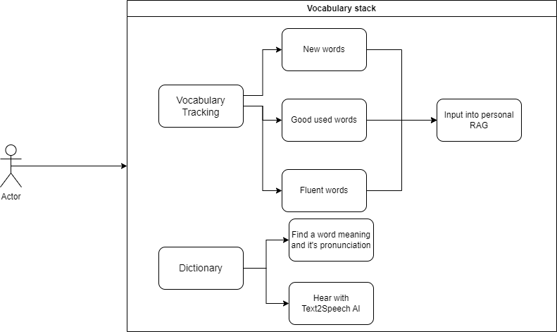
05. Desired Outcome – Core Functions
Vocabulary Stack - Simple flowchart

Slide 15


05. Desired Outcome – Core Functions
User Tracking
User learning growth system
Guidelines for users' common mistakes in each skill

Slide 16
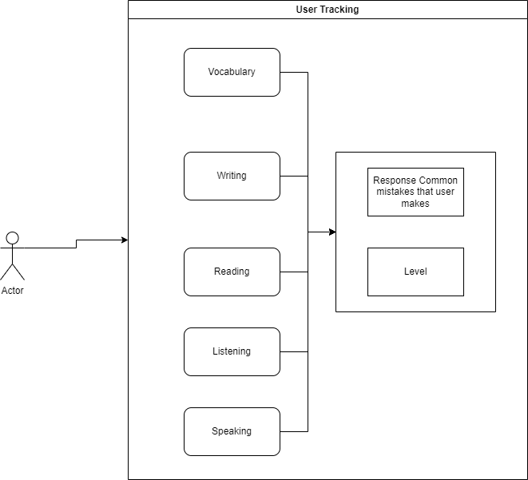
05. Desired Outcome – Core Functions
User Tracking - Simple flowchart

Slide 17


5. Desired Outcome – Core Functions
Level Up System
3 steps
User Account
3 levels
Evaluate user performance in the playground (4 skills + vocabulary) in various topics
Points awarded for excellent performance, deductions for poor results

Slide 18

05. Desired Outcome – Uniqueness
Utilize state-of-the-art techniques
LLM, RAG and Functions Calling
Personalize user learning path with RAG
Various topics generated by AI or user's preferences
AI evaluation

Slide 19
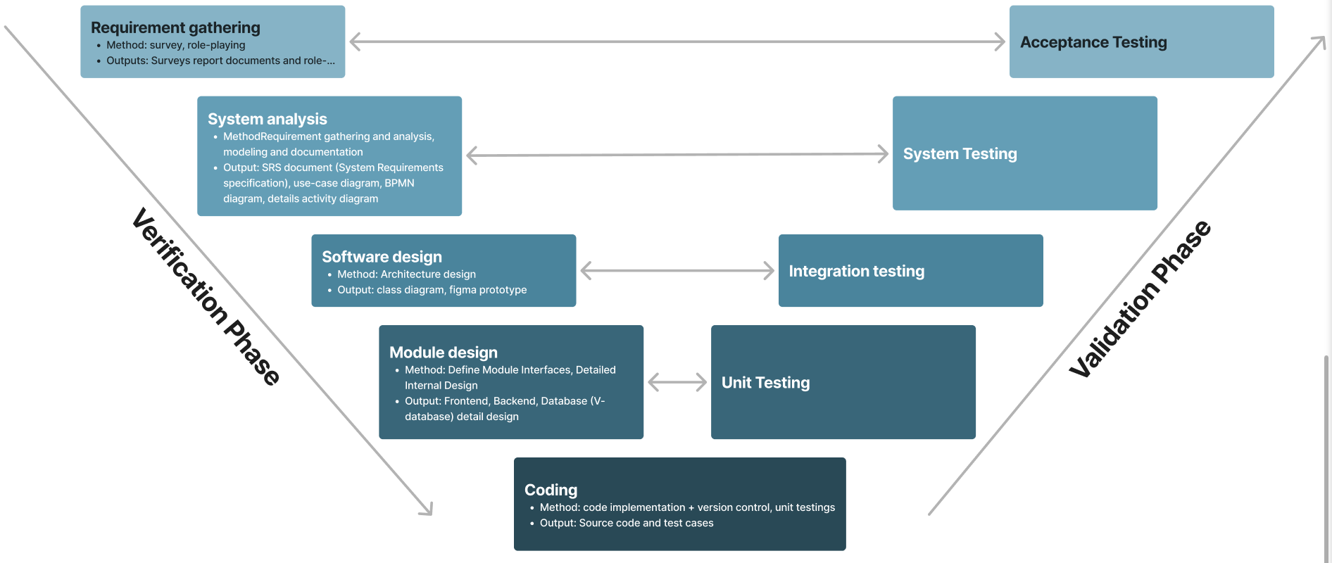
06. Research Methodology

Slide 20
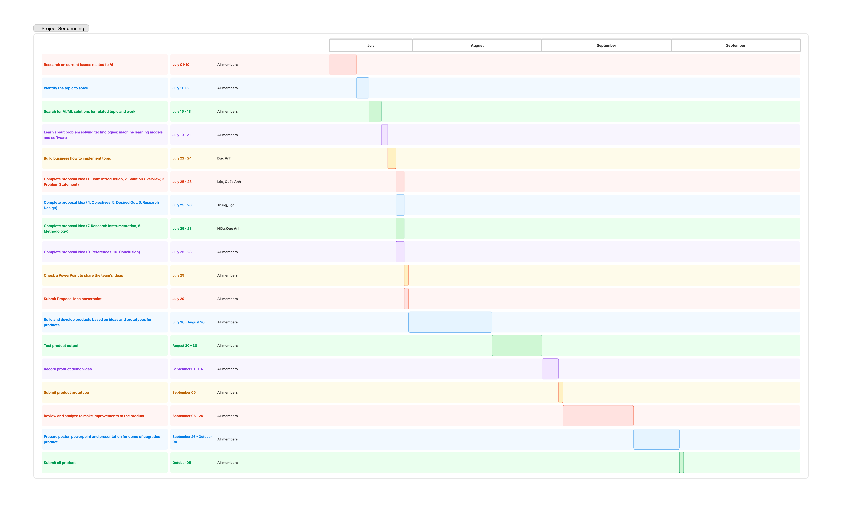
06. Timeline (enable fullscreen)

Slide 21
06. Timeline

Slide 22
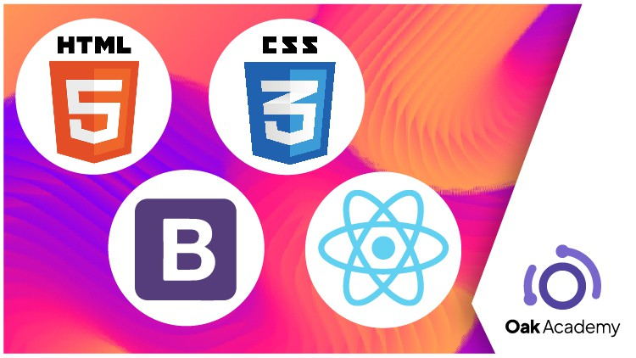


07. REASEARCH INSTRUMENTATION
Frontend: we use a variety of tools including ReactJS, HTML, JS, CSS. These technologies will help us create a responsive and user-friendly interface.
Backend: we will utilize FastAPI and Django to handle our server-side logic and API endpoints efficiently.
Large Language Models (LLM): we plan to integrate GPT-4 APIs, Retrieval-Augmented Generation (RAG), and LangChain framework to enhance our natural language processing capabilities.

Slide 23


07. REASEARCH INSTRUMENTATION
Prompting techniques: including Chain-of-Thought and Tree-of-Thoughts (ToT), which will help in structuring complex queries and responses.
Text-to-Speech: we employ the TTS model by GPT, ensuring high-quality and natural-sounding speech synthesis.
Speech-to-Text: using GPT's Whisper, which offers accurate and reliable transcription.
Virtual MC interaction: we will leverage Heygen, providing an interactive and engaging speaking experience.

